Slide 1
Travel Class for Frequent Travelers
Recreation Therapy Department

Slide 2
Outline:
Tips for pre-travel preparation
Tools/Equipment to take with you
Tips for luggage management
General Air Travel Tips
Ground Transportation Tips
Hotel Tips
Cruise Tips

Slide 3
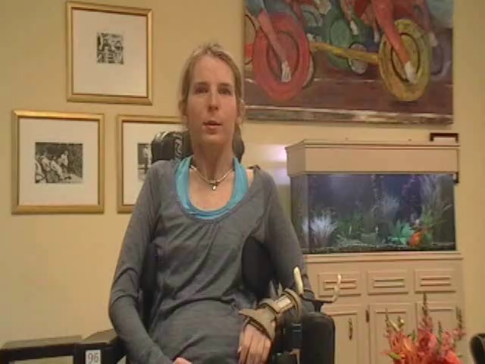
Meet our panel of “experts”
Notes:
Cindy- C3-5
Devin- neurological condition
Minna- para
Robert- para
Shane- C4-7

Slide 4
Preparing for Your Trip
Know your skills/needs
  Tub transfer?
  Toiler transfer?
  Bed transfer?
Research your Destination
Plan for Equipment needs
  Taking, shipping, or renting?
Plan for caregiving needs
  Taking or hiring?
Notes:
Depending on the length of your trip, consider mailing medical supplies to the hotel rather than packing with you. Or have your supply company ship straight to the hotel.
Learn to do slide boards transfers- even if dependent- to eliminate the need to travel with a hoyer
Take any tools that you might need (allen wrench for example)
Make yourself a packing list of things you need for every trip- keep it in your suitcase or on your phone so you can add to it if you discover something you didn’t take that you want to make sure you have next time

Slide 5
Knowing Your Rights
American’s with Disabilities Act: adopted in 1992, revised in 2010.
Air Carriers Access Act (14 CFR 382): adopted in 1986, revised in 2008
  Compliance is required of all carriers flying into and out of the United States. Domestic and International carriers are required to comply under an amendment called Air 21.
  http://www.pva.org/site/PageServer?pagename=rights_aircarrier&AddInterest=1042
International travel laws?
Notes:
It is important to note that air travel is not covered under the Americans with Disabilities Act. The Air Carriers Access Act is the law that protects your right to fly and prevents any commercial airline from discriminating against anyone and refusing service solely on the basis of disability.
We are not going to go into the in’s and out’s of the law, but if you would like to know any other information or more specifics, you can access the Paralyzed Veterans of America website at www.pva.org, which contains an excellent summary of the law. We have one copy here if you would like to look at it, or if you want a copy for your own records, please talk to your recreation therapist and they can get it for you.
Website: http://www.pva.org/site/PageServer?pagename=rights_aircarrier&AddInterest=1042 , which takes them directly to their interpretation of the regulations (easier to interpret than the regulation itself) and http://airconsumer.ost.dot.gov/rules/382short.pdf for a verbatim copy of the regulation that can be printed off and carried for access while traveling.
Other countries have laws regarding accessibility in air travel, however they may only pertain to certain types of disabilities or to the actual flight experience while others pertain to different types of disabilities and the airport experience as well. (Examples include: Israeli Code of Practice from the Israeli Ministry of Justice in 2008, Canadian Code of Practice from the Canadian Transportation Agency in 2008, and the UK Department for Transport Code also from 2008) Research your destination if flying to another country to find out what their laws are and what you can expect in terms of assistance and accomodations.
It’s also important to note that while domestic carriers are required to cover any damage to your mobility device; international carriers maximum reimbursement rate is limited to $1000. So you may want additional insurance when travel internationally to cover the cost to any damage to your mobility device.
You can join the Association for Airline Passenger Rights- membership is $10.

Slide 6
Making your reservation:
Be specific in your needs
  Transfer assistance for flying; type of shower in hotels, wheelchair measurements
Don’t be afraid to ask questions
Be prepared with suggested solutions to any obstacles
Book as early as possible
Notes:
Personal care attendants are required to be placed beside the traveler with a disability- so when you request the bulkhead seat, your travel companion gets to sit with you.

Slide 7
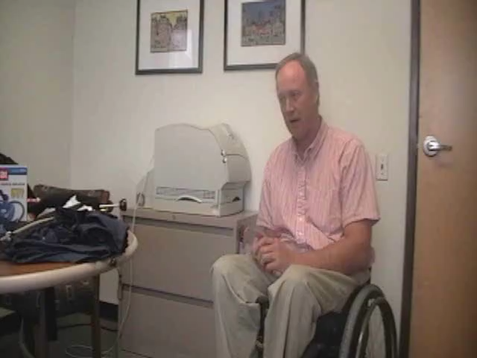
Packing suggestions:
Notes:
Packing for road trip is different from packing to fly- you have more room when you’re driving so might take an air compressor if you have air tires (vs just bike pump for flying), your own portable hand controls for faster car rental
Take rain clothes- so when it rains can take cushion cover off, where rain pants and coat- then when you get to destination can take off the rain clothes and put dry cushion cover back on cushion
Fanny pack- use on feed (wrap around ankles so it rests om your feet in front of you) – easy for you to access with forward lean but not in good place for pick pockets or thieves to steal
Bathroom equipment- use garden kneeling pad for cushion in tub OR get collapsible kitchen stool to make seat in the OR use action pad to pad tub bench in hotel room or on bottom of tub OR take home bathroom equipment- ship ahead or pack with you OR request plastic chair, like pool chair, to use in shower with action pad on it for padding

Slide 8
Packing for your Trip
Medications & personal care supplies
Bathroom or transfer equipment
List of the following in case of emergency:
  Physicians’ Names, Numbers, & Addresses
  Medications
  Medical Diagnoses
  Insurance Information
Notes:
Your thoroughness in packing can greatly impact the success of your trip.
Medications: Make sure you bring all medications with you. Do not pack them in your luggage that will get stored in the cargo area. Make sure to put all meds in your carry on luggage.
Personal Care Supplies: Again, make sure you bring all necessary personal care supplies. Always bring extra, for most of your supplies could potentially be very difficult to find in a regular drug store. You always want to be prepared in the event that something out of the ordinary occurs. As with your medications, you want to pack your personal care supplies in your carry on luggage. If your stored luggage gets lost, at least you will have your personal care supplies on board with you. It is important to note that you are not limited to the one bag maximum for carry on. Any personal care supply that you need can be brought on board with you.
Important Documents to Keep With You:
List of Medications: In the event that you have an accident or need emergency medical care, it will be much easier to tell unfamiliar doctors the medications you are on, including names and dosages, and what you are taking the med for.
Physicians Names: Again, if something happens and you need a prescription called in or an emergency doctor needs to find out medical information on you, having your physician’s name readily available will make the process easier.
Medical Diagnosis: With your physician information, having your level of injury, any residual effects from the injury, medical conditions, etc, may prove to be useful in the event of an emergency. If you are at risk for autonomic dysreflexia, having your dysreflexia card will be helpful to hospitals/doctors that may not be familiar with the medical emergency.
*Always keep you insurance information close at hand, again, in the event of an emergency.
**If you are traveling to a foreign country, there is a service provided by the International Association for Medical Assistance to Travelers where you would be able to get a list of English Speaking medical providers by country. This resource is in your travel resource packet.

Slide 9
Airport Security
TSA provides ongoing training with their security screeners on appropriate screening techniques for people with different types of disabilities
Because many disabilities are not visual, all TSA officers are required to ask any passenger in a wheelchair “are you able to stand, is your party able to assist you with standing or lifting and/or are you able to use upper body strength to lift yourself?” (to check the cushion).
TSA CARES can be contacted about 72 hours before travel at 1-855-787-2227 to have a TSA Passenger Support Specialist escort you through the security checkpoint so TSA can ensure you will be provided with the appropriate level of assistance you need.
Notes:
Never be afraid to ask to speak with a manager if you feel like the TSA agent you are working with is not understanding your needs or is asking things of you that you cannot perform. You don’t have to explain your disability or your personal care needs- if you have adapted equipment (ex. dining with dignity fork) or medical supplies (ex. Vaseline or lubricant) that you need for your personal care than simply stating “I need that for my personal care” is sufficient – if they have a question or aren’t listening, ask to speak with a manager.

Slide 10
Air Travel Tips
For Domestic flights arrive at least 1.5 - 2 hours prior to departure and For International Flights arrive at least 2.5 - 3 hours in advance of your flight. You must be at the gate 15 minutes prior to boarding for domestic flights and 45 minutes prior to the boarding of any international flight.
Do NOT check your chair as baggage.
Confirm seating and transportation/boarding assistance needed. Transfers always occur at the door of the aircraft.
Secure all removable parts of wheelchair.
For power wheelchair- laminate instructions on the wheelchair for how to disengage the motor and secure your drive system.
Notes:
Do Not check your chair! You will however need to put a GATE Tag on your chair-not a normal baggage claim ticket. The gate tag will ensure that your chair is brought directly to the gate at your final destination without going through baggage claim.

Slide 11
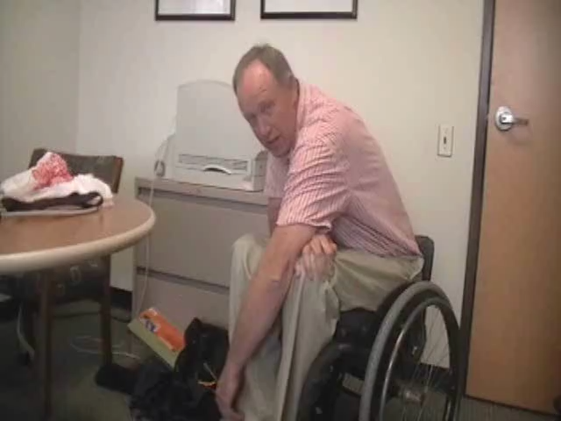
How do you manage your luggage?
Notes:
Can get luggage “forks” which attach to front posts of the wheelchair- to rest luggage in front of you above your feet. Robert makes Velcro loop around suitcase handle and puts strip of Velcro on the bottom of his seat so he can connect it to hold the luggage for him. Uses duffle bags to hang on back of the chair by the two straps. Also carries duffle or carry-on suitcase in his lap. So he can actually have all 3 of those bags at the same time and still be hands free.
Minna- parks at the airport park n’ ride, tells the shuttle driver she needs help with her luggage and tips the driver, does curbside check-in for checked luggage and tips the porters. At her destination she does the same thing- tips a porter to get her luggage from baggage claim to her ground transportation.

Slide 12
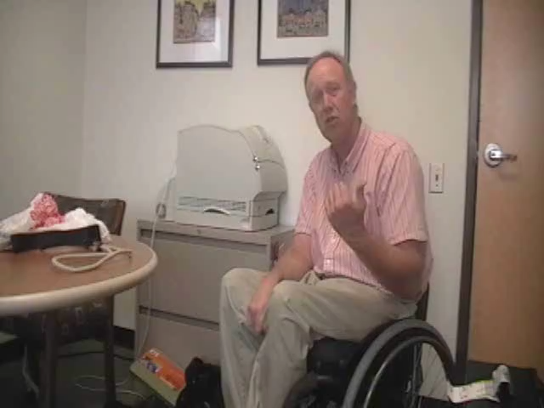
Plan for Bowel/Bladder needs
Notes:
Robert- takes empty soda bottle and a plastic bag and does IC into bottle in his airline seat under a blanket in his lap- he then puts everything in the plastic bag and gives to flight attendants when they collect the trash. Also doesn’t drink a lot when traveling but if he does it’s milk or orange juice that he feels like give him nutrients as well as fluid
Cindy- has foley put in before her flight and then uses foley while traveling. Removes foley at her distination and ICs as usual.
Minna intentionally dehydrates herself (drinks less) before she travels so she ICs before she boards and again when she deplanes- and then makes sure she hydrates as soon as she lands. She avoids caffeine and alcohol the day before she travels.
Everyone said avoid spicy foods, dairy, or things you know may upset your stomach in terms of your bowel program.
Some frequent international travelers perform a bowel cleanse before their scheduled trip to reduce the chances of a bowel accident during travel.

Slide 13
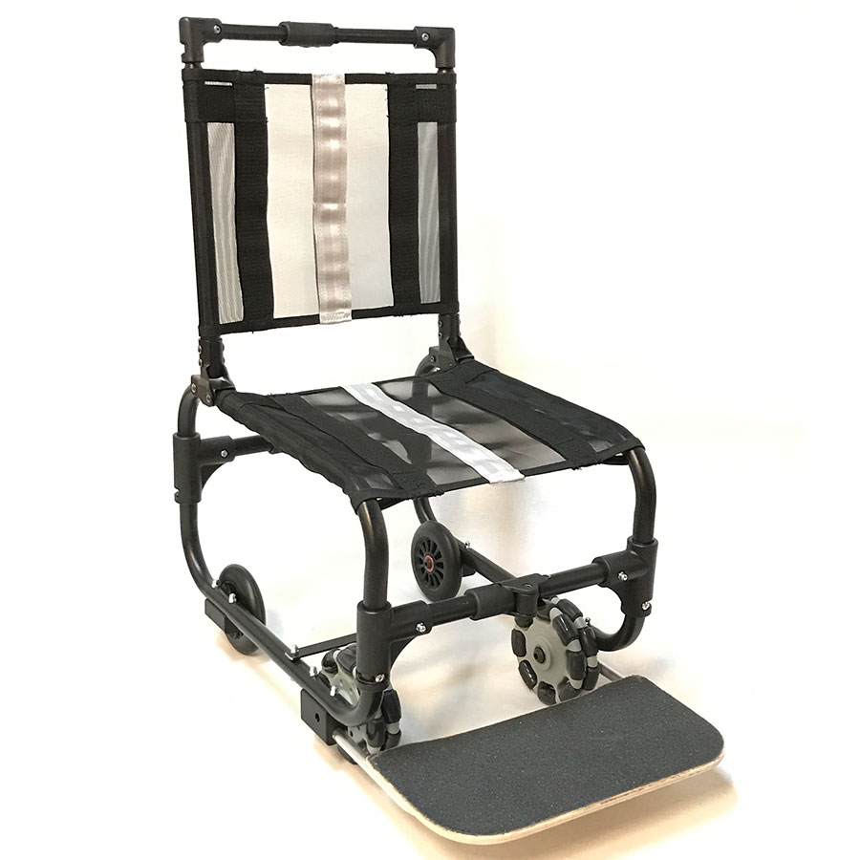
Tips for on board the airplane:
Sit on wheelchair cushion in the airplane
  Air vs gel cushion
Take something along if you will need it to put under your feet so your knees are at a 90° angle
Chest strap?
Know how you will do your weight shifts
Option for personal aisle chair
  https://www.epicalsolutions.com/post-portfolio/icon-wheelchairs-aisle-chair/
Notes:
If using something to help prop your feet up, you may be asked to remove it during take off and landing 2’ FAA regulations, however the flight crew can help you position once permissible during the flight if needed

Slide 14
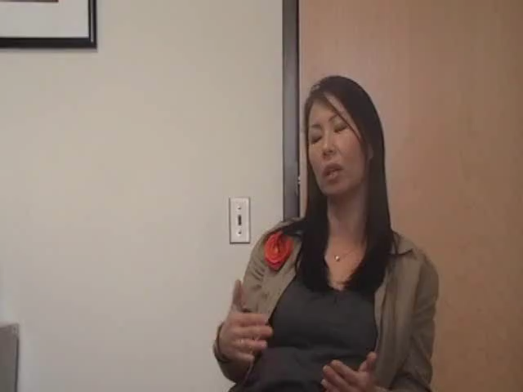
Window or Aisle seat?
Notes:
Minna usually requests the aisle seat because she doesn’t want to do any more transfers than necessary. She said men typically request a window seat because it’s easier for them to hide the IC process if they have that more private space. However, she acknowledges that sitting in the aisle seat means people have to “climb” over her to get in/out and she finds that annoying so may try a window seat the next time she flies.

Slide 15
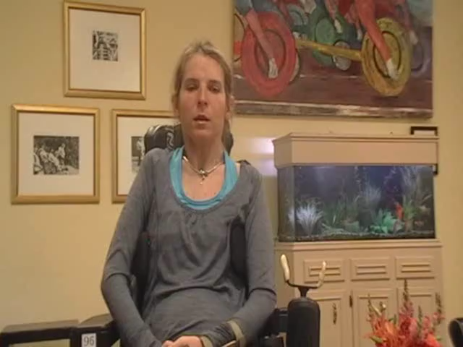
Cindy’s onboard seating tips:
Notes:
Cindy travels with a lot of pillows which she uses for positioning in the seat- pillows under her feet so she’s balanced and also around her. She doesn’t like to use a strap for a chest strap, although she has. She prefers to go without and then just has her traveling companions brace an arm across her during take off and landing when her seat has to be the most upright and turbulence is worst.

Slide 16
Ground Transportation
Accessible hotel shuttles
Rental cars
  Portable hand controls
Public transit
Regional transportation:
  Amtrack offers discount fares for travelers w/ disabilities
  Grey Hound offers 50% discount for personal care attendant traveling with traveler w/ disability
Tips for foreign countries
Notes:
If a hotel offers a shuttle from the airport they are required under the ADA to provide an accessible option. Give them some advance notice (call before you leave home) so they have time to set something up if they don’t have an accessible shuttle on hand.
Rental car companies rent hand controlled vehicles but it may take them extra time to get the car set up for you. You can also take your own portable hand controls and install them yourself. If they can only (because of the company policy) have hand controls put in larger vehicles and you want to rent an economy car, they cannot charge you more for the larger vehicle.
In NYC, not every subway stop is accessible- it’s more like every 3rd stop
In foreign countries you may be able to hire accessible transport or you can rent vehicles and install your hand controls. You may or may not find their public transportation accessible- and in many cases while the transportation itself my be accessible, the train stations might not be so be prepared. Many people who routinely use a power wheelchair in the states, find that travel internationally is much easier with a manual wheelchair due to the accessibility concerns.

Slide 17
Hotel Tips
Handicap vs. wheelchair accessible
Bedroom accessibility
  Bed height
    Removing box spring or box frame from underneath
    Learn to do dependent slide board if possible to eliminate need to travel with hoyer
  Extra furniture
    Ask for pictures of the room
  Evacuation plan?
Notes:
You can ask for extra furniture to be removed to create more space in your room. When you call ahead to hotels to ask about accessibility- ask to speak to the head of housekeeping or engineering, those are the people who really know the rooms and what can be done to make them ore accessible. They are also the ones to talk to when you arrive to make special requests.
Some hotels in Las Vegas actually have overhead hoyer installed in some of their accessible rooms!
If your room is not on the first floor, be sure you know what the plan is in the event of an emergency when the elevator would be inoperable.

Slide 18
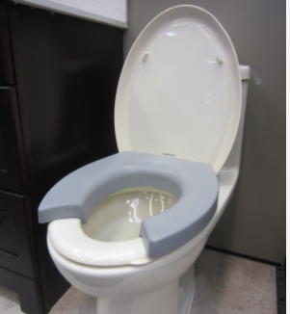
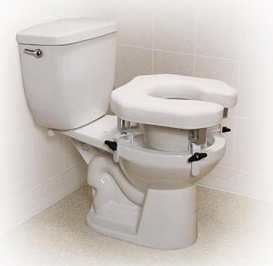
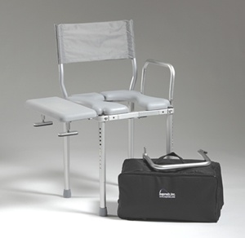
More Hotel Tips
Bathroom accessibility
  Toilet tools
    K cushion https://www.kcushion.com/
    Adjustable padded raised toilet seat http://www.elderdepot.com/customer/product.php?productid=1173&cat=271&page=2
    Nuprodx http://www.nuprodx.com/chair3000tx.htm
  Bottom of tub tools
  Roll in shower
  Contact ALS Society or MS donor closet to see about renting equipment or ask DME company at your destination
Notes:
K cushion – is stackable so if need more space to reach for bowel program could buy more than one and stack them.
If doing bottom of the tub transfers you can sit on your action pad or car cushion to protect your skin. Also consider using a small stool in the tub so you don’t have to get all the way down and back up.
Some frequent travelers who are able to transfer into the bottom of the tub actually do their bowel program in the bottom of the tub- thus eliminating the need for both tub and toilet equipment. And clean-up is as easy as turning on the shower.
If you don’t have a shower chair at the hotel and need one, consider asking the hotel to bring a pool chair to your room, which you can then use in the shower.
A wastepaper basket and garbage bag will work for bowel program. In case the toilet is not accessible, or you don’t want to travel with your toilet seat, you want to make sure you bring supplies, like chuck pads, so you can do a bowel program in bed if needed.
While hotels are required to have a certain ratio of accessible rooms, only a small percentage of those have to have a roll in shower. If that is a feature you need, book your room as early as possible and be very specific in your reservation that you need a roll in shower. Even with a roll-in shower, they may not provide the shower chair

Slide 19

Shane’s hotel bathing tips:
Notes:
Shane often just does a bed bath if he’s only away from home a couple days. He doesn’t sweat like he used to so finds he doesn’t need to shower as often. He will use dry shampoo or has a bed basin for washing his hair if his hair is getting dirty. If he’s going to be traveling for more than a couple days, he makes sure to get a hotel room with a roll in shower so he can get a shower when needed.
You can purchase a bed basin for washing hair in bed from companies that sell elder care products.

Slide 20
Cruise line Tips
Accessible cabins book up fast! Make your reservations as early as you can.
Know your wheelchair measurements and be specific when booking your cabin
Ask about the access to land excursions (dock vs. transport boat)
Research your options for any desired excursions
Notes:
Most cruise lines allow you to check out the rooms on-line and you can look up where the accessible rooms are and also other accessibility features on the ship.
Be sure you are booking a wheelchair accessible room that allows your wheelchair access to the room. There are 3 types of accessible rooms on a cruise ship. Some “accessible” rooms are larger inside but have a threshold and narrow doorway that won’t allow the wheelchair into the room. They are set-up for individuals who use scooters for long distance mobility but are able to ambulate with an assistive device for inside the room. If you use a wheelchair for your mobility, you want tomake that clear and request a fully accessible room.
You may be able to book private excursions for those land destinations you’d like to see where the regular tours are inaccessible. Plan ahead and be prepared to be flexible. Also make sure you feel safe with whatever accommodations are provided. Example: A former pt booked a private van tour to see the volcanoes in HI and there were no tie downs in the van- on the steep inclines going up the mountain her wheelchair slid backwards and she was propelled into the rear wall of the van causing her both neck and head injuries.
If you book your cruise through a travel agent that specializes in accessible travel, they can book accessible excursions for you. This also gives you a liason to help navigate through the process if anything goes wrong or isn’t what you scheduled.

Slide 21
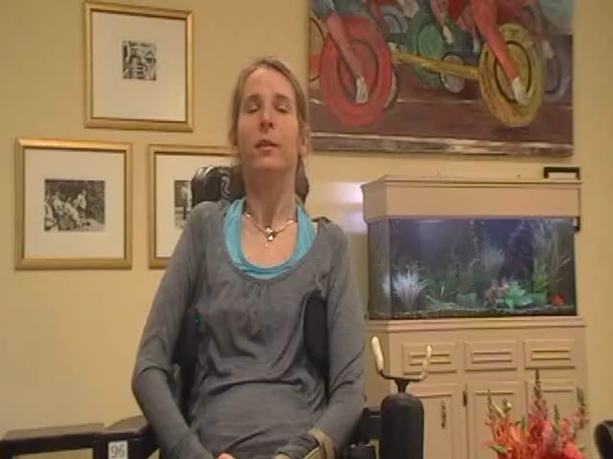
Where there’s a will, there’s a way:
Notes:
Cindy went on a trip to Alaska with her boyfriend- firs time they had ever traveled just the two of them.
She had hired an attendant to come in and do her bowel program while they were there. However, the attendant didn’t show up so she had to talk her boyfriend through giving her a bowel program. They didn’t have a toilet chair because her plan had been for the attendant to do the program in bed, but that seemed worse to her for her boyfriend with all the clean-up so she didn’t want him to have to do that. They ended up problem solving using the luggage rack from the hotel room over the toilet with her balance on it so he could do the bowel program between the slots of the straps.
She had also wanted to do one of the offshore tours where they could view the whales feeding on salmon. But when they called around to the most popular companies, they were told the boats were not accessible and it couldn’t be done. They kept trying and found a little family owned business where the owner was willing to make what accommodations they needed. So, using the shower chair from the hotel, the owner and her boyfriend lifted her into the helicopter to get out to the boat. She was strapped into the shower chair using rainbow luggage straps and pillows supporting her feet. They then lifted her into a little rowboat type dingy and went out with her all strapped in the shower chair – and they had the best time. She said they loved watching the wildlife and just really enjoyed themselves. While they were out in their little dingy, a huge pontoon boat went past- from one of the companies that said they weren’t accessible. And she could tell by looking at the boat that it would have been so easy but that company just didn’t care. Her little guide was willing to do the work to get the business.
Cindy believes where there is a will, there is a way- you just have to be persistent and creative to get what you want.

Slide 22
Travel Resources
Internet
Organizations (United Spinal Association’s Able to Travel; Access to Travel)
Summaries of the laws protecting your rights
Magazines/Publications (Venture)
Travel Agencies
Airline websites and brochures about customers with disabilities. https://www.delta.com/us/en/accessible-travel-services/overview

Slide 23

Final advice from our experts:
Notes:
Devin recommends planning ahead when you’re going to travel and do your homework. Even calling ahead to restaurants and places along your travel route to ask them about accessibility. Because of the ADA, places have to be accessible but even with little mom and pop business, if you tell them what you need, a lot of times they can accommodate you.
Shane says just go travel and the more you do it, the more comfortable you will be. Don’t be scared. Just because you’re in a wheelchair doesn’t mean you have to stay in one place. Go see the world.

